Slide 1


Housing Application Guide

Slide 2

Enter your student email address and the password used to access your student email account.

Slide 3
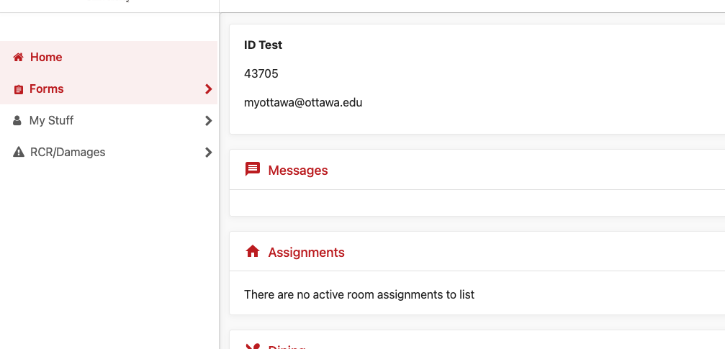
Your contact information will appear here.
Click on the link on the left side that says “Forms.”

Slide 4
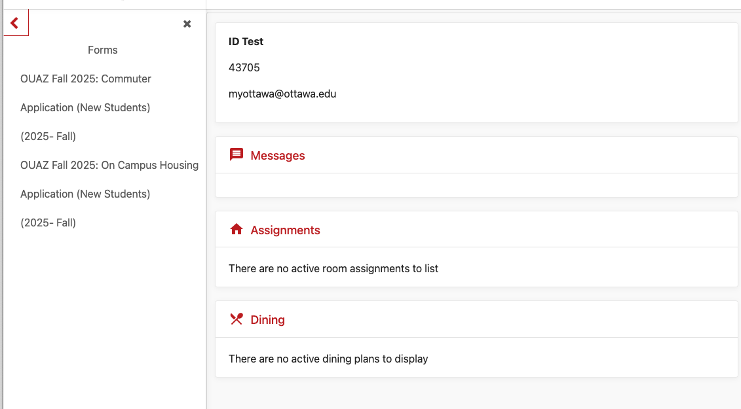
Complete the appropriate application:
Commuter Application: If you plan to live off campus.
On Campus Housing Application: If you plan to live on campus.

Slide 5
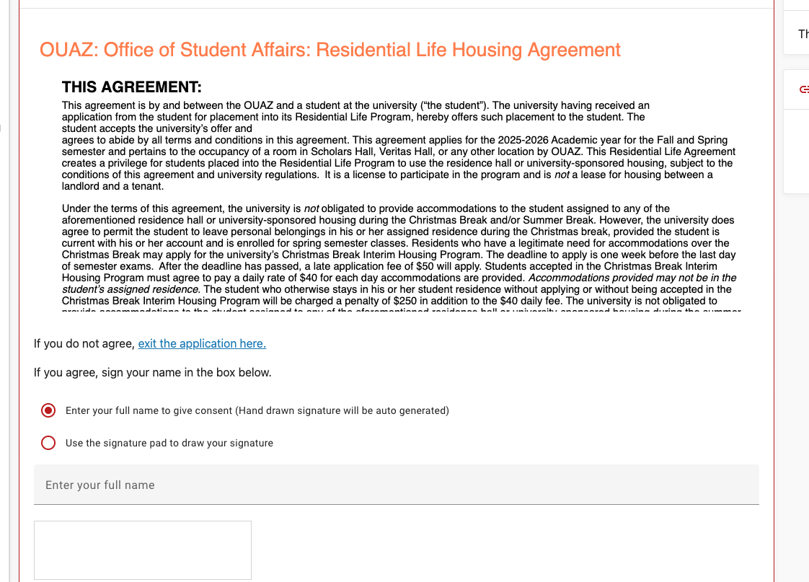
When completing the On-Campus Housing Application:
Read the OUAZ Office of Student Affairs Residential Life Agreement.
Either type your full name or sign in the white area using your mouse.
Note: When completing the Commuter Application, you do not sign the Residential Life Agreement.

Slide 6
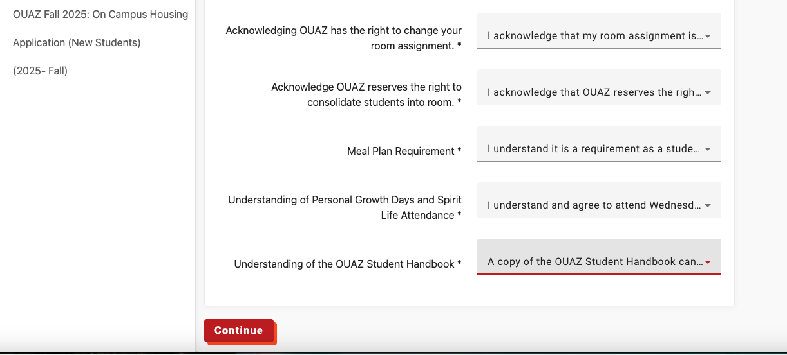
The Commuter Application and On-Campus Application each contain a series of questions. Complete the questions and then click “Continue.'"

Slide 7
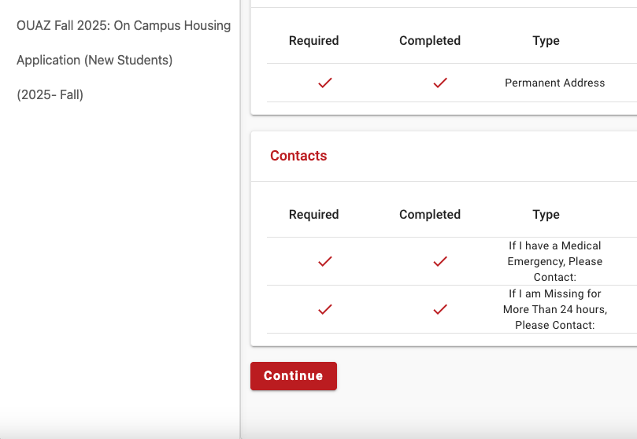
For the Commuter Application:
You only need to complete the section titled "If I have a Medical Emergency, Please Contact:"
For the On-Campus Housing Application:
You must complete both:
"If I have a Medical Emergency, Please Contact:"
If I Am Missing More Than 24 Hours, Please Contact:”
Then, click “Continue.”

Slide 8
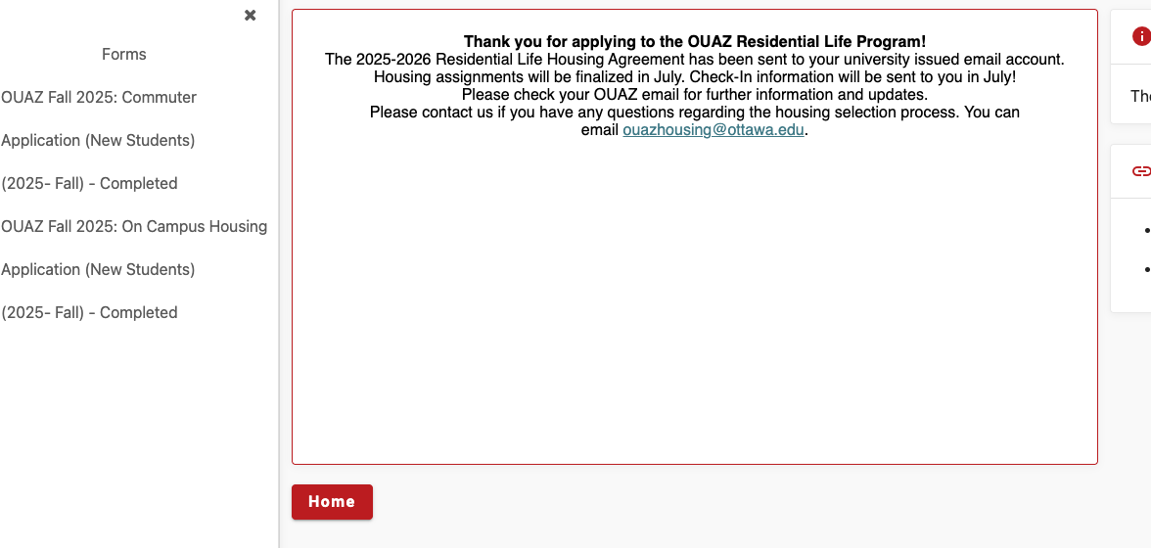
Congratulations! You have successfully completed either the Commuter Application or the On-Campus Housing Application.
Now, Student Affairs will begin the process of assigning rooms and roommates/suitemates if you completed the On-Campus Housing Application. Residential students should look for information via their student email in July regarding housing placements.
Questions: ouazhousing@ottawa.edu

